Slide 2
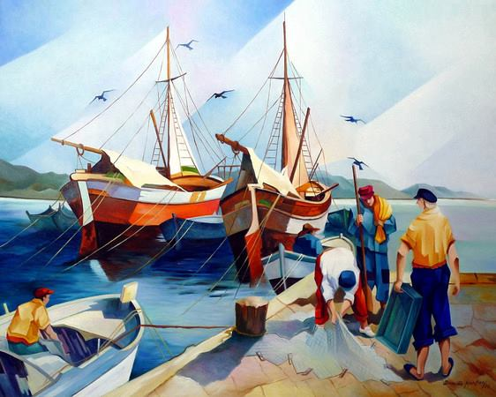

Slide 3
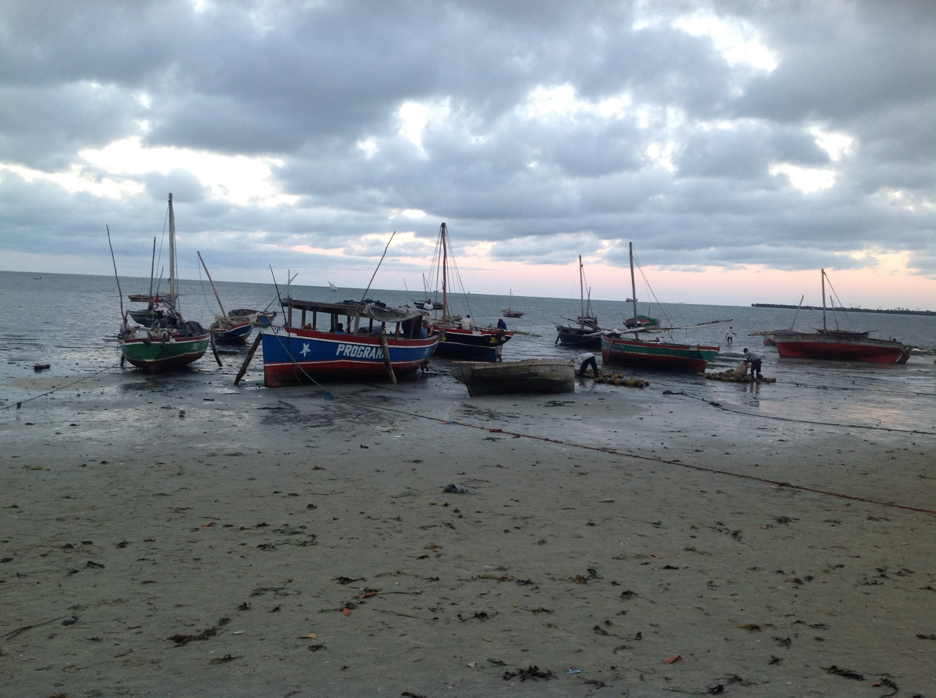
Tu has venido a la orilla
Tu te abeiraste da praia
Lord, when you came to the seashore,

Slide 4
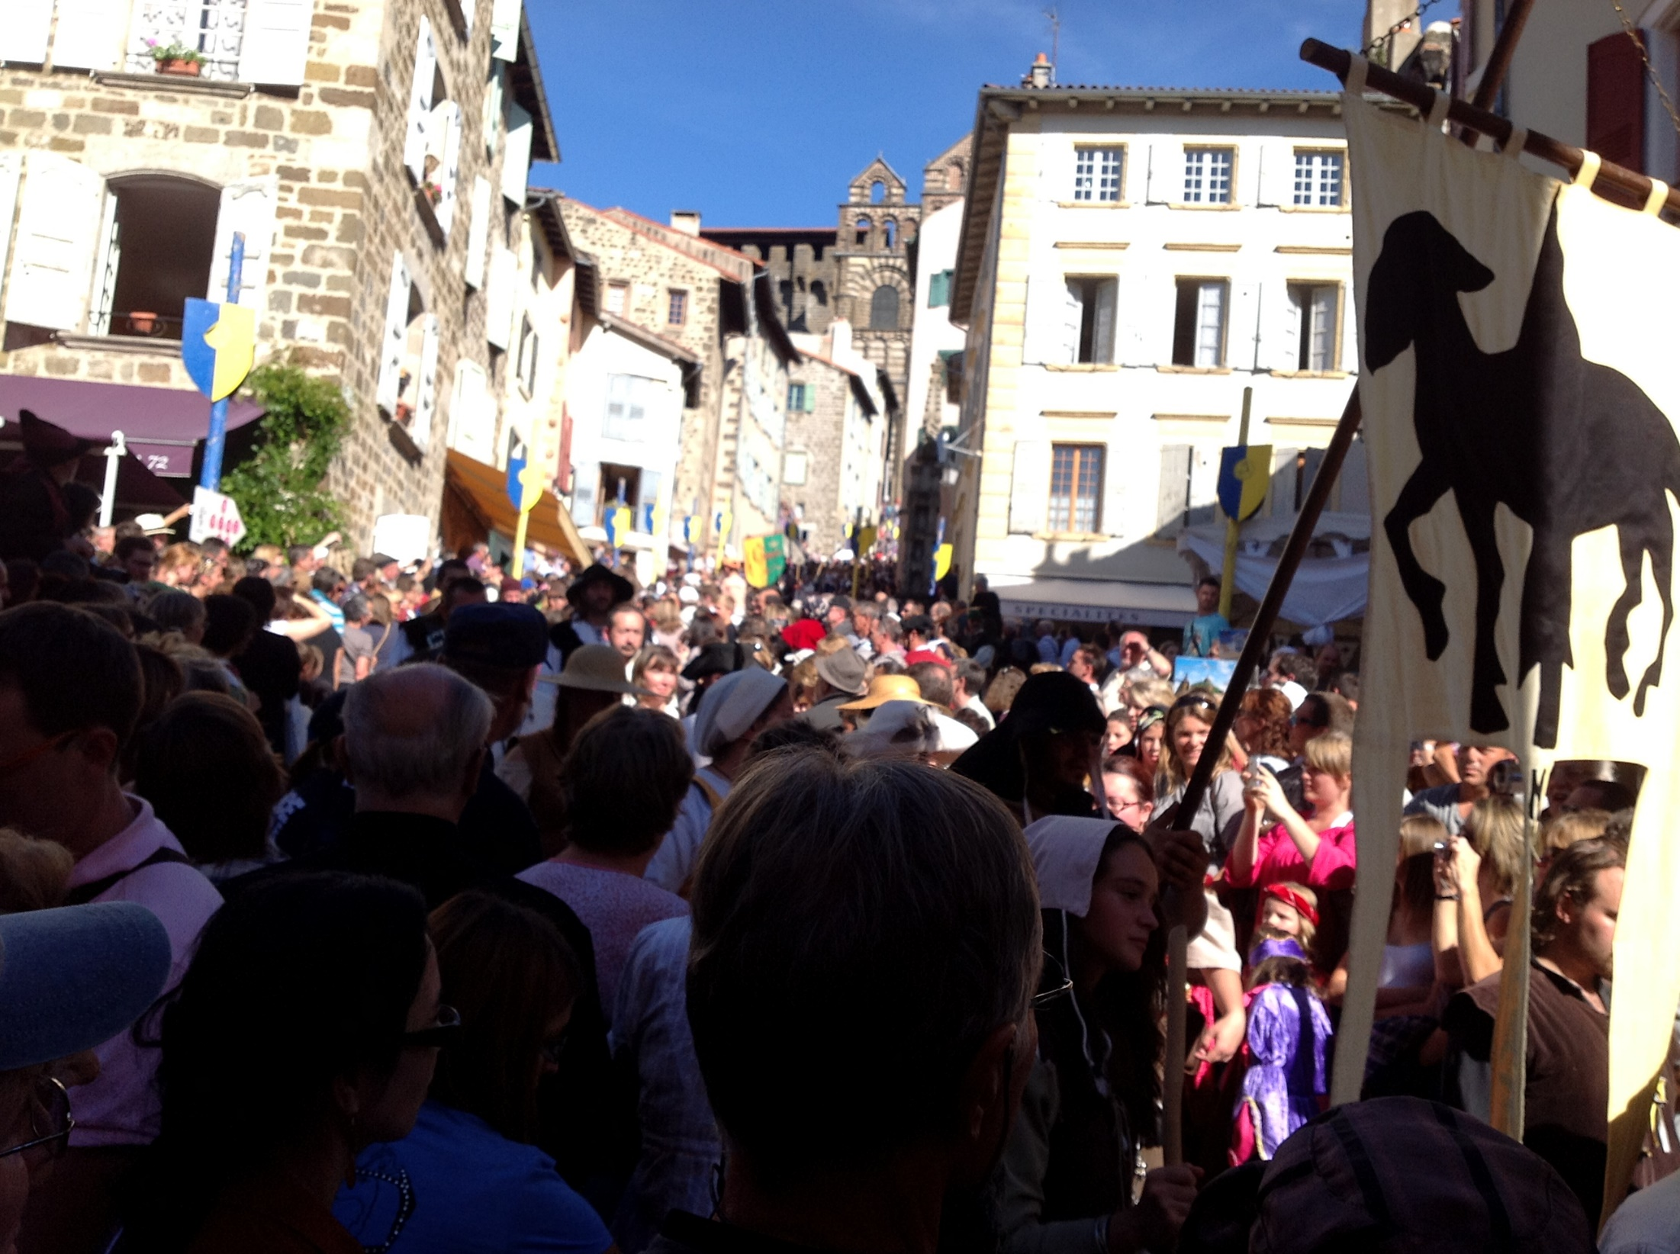
No has buscado a sabios, ni a ricos
Não buscate nem sábios, nem ricos
You weren’t seeking the wise or the wealthy

Slide 5
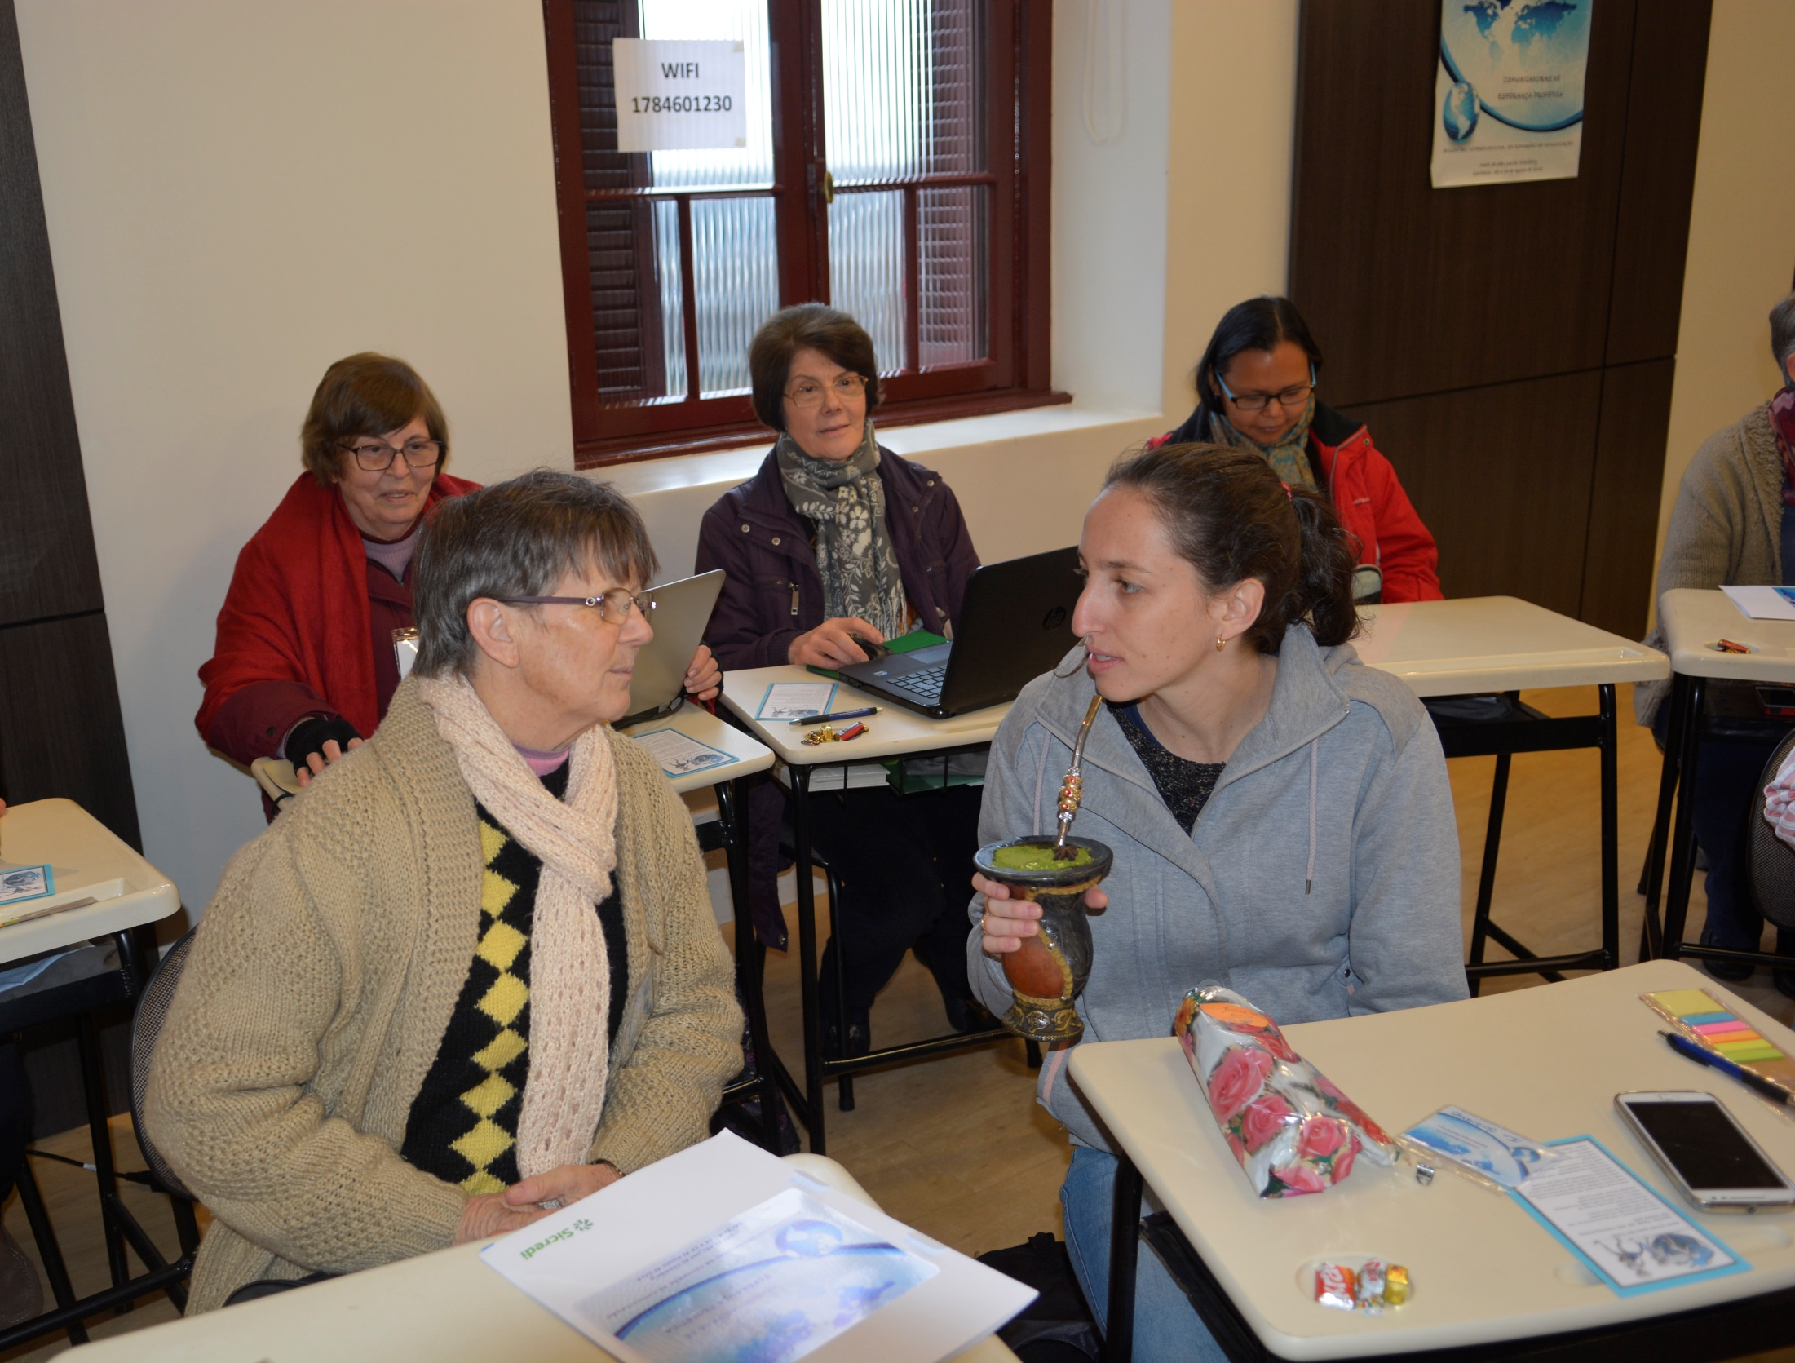
Tan solo quieres que yo te siga
Somente queres que eu te siga
But only asking that I might follow.

Slide 6
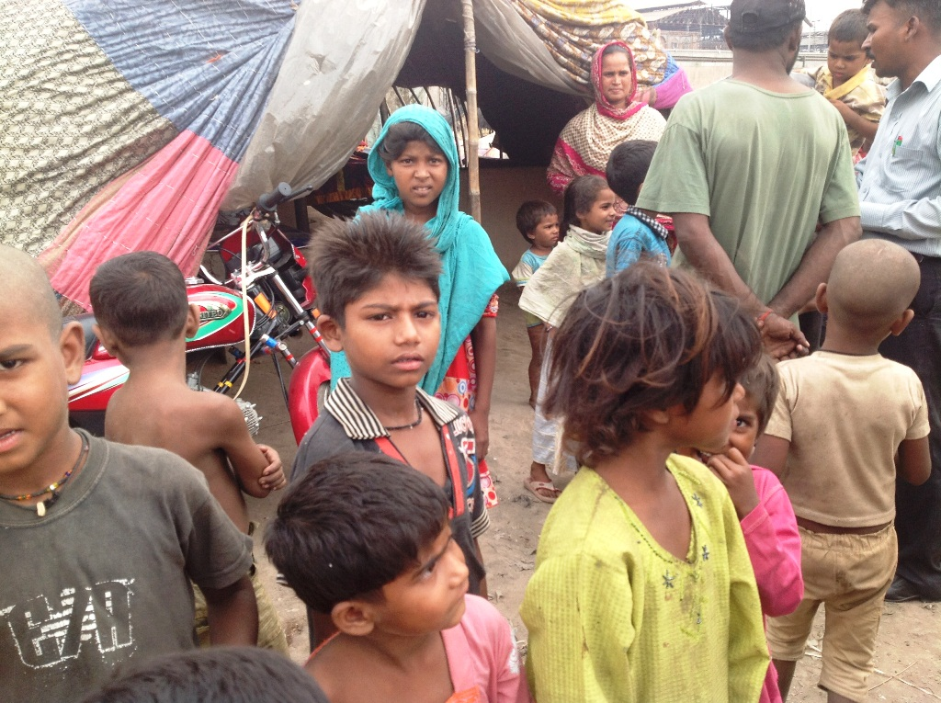
Señor, me has mirado a las ojos
Senhor, Tu me olhaste nos olhos
O Lord, in my eyes you were gazing

Slide 7
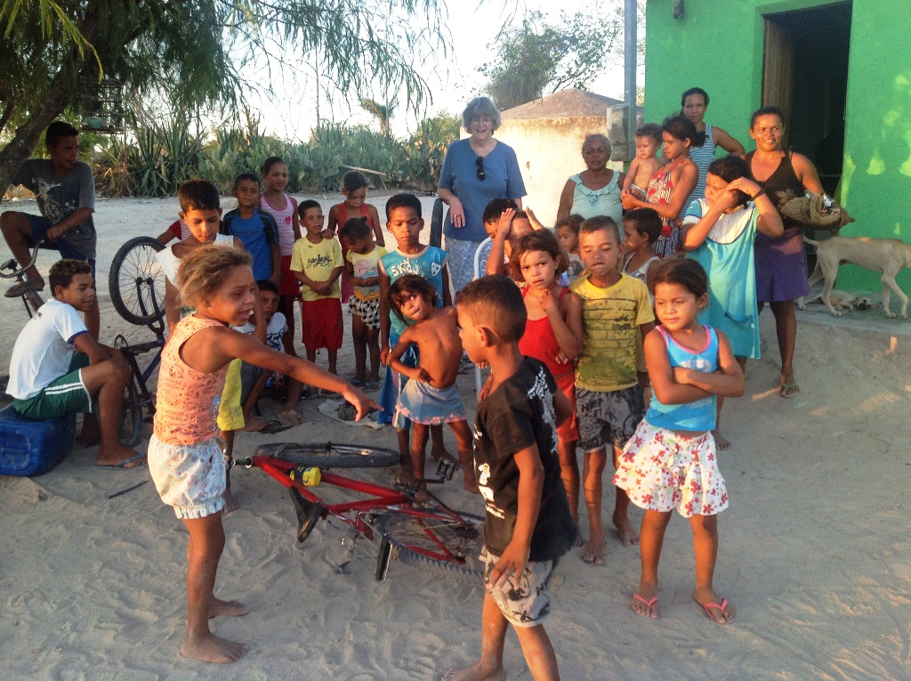
Soriendo, has dicho mi nombre
A sorrir, pronunciaste meu nome
Kindly smiling my name you were saying

Slide 8
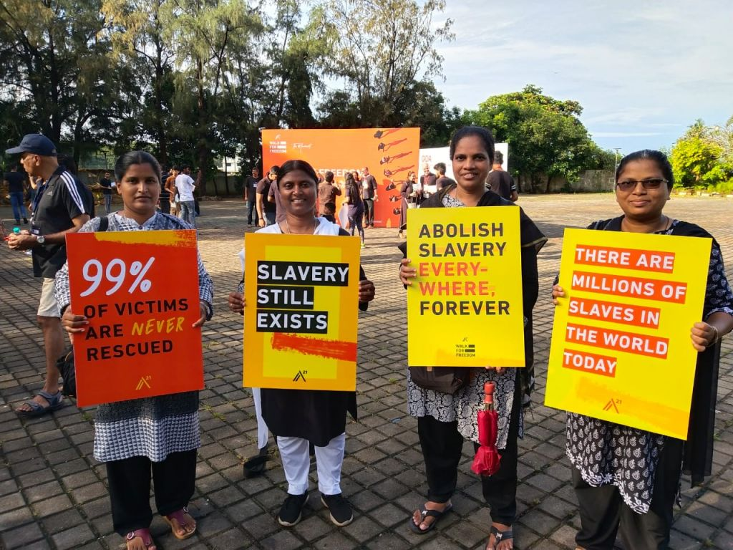
En la arena, he dejado mi barca
Lá na praia, Eu deixei o meu barco
All I treasured, I have left on the sand there

Slide 9
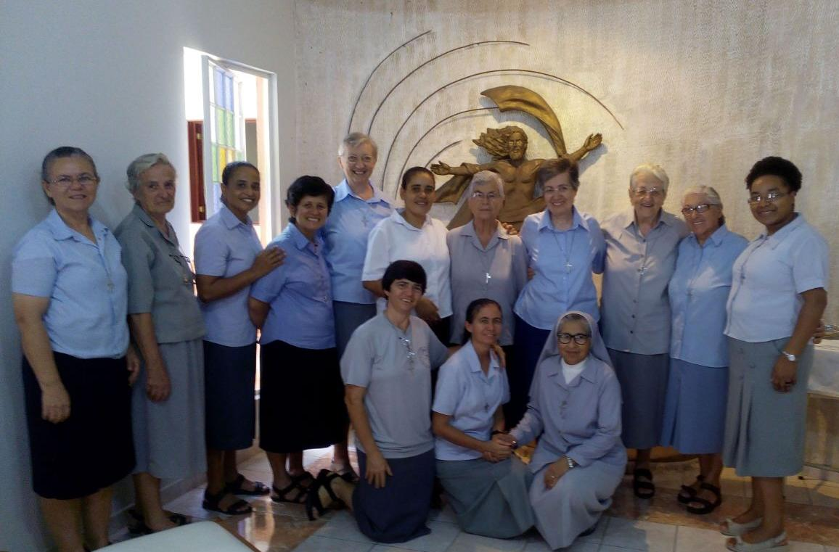
Junto a ti, buscare outro mar
Junto a Ti, buscarei outro mar
Close to you, I will find other seas

Slide 10
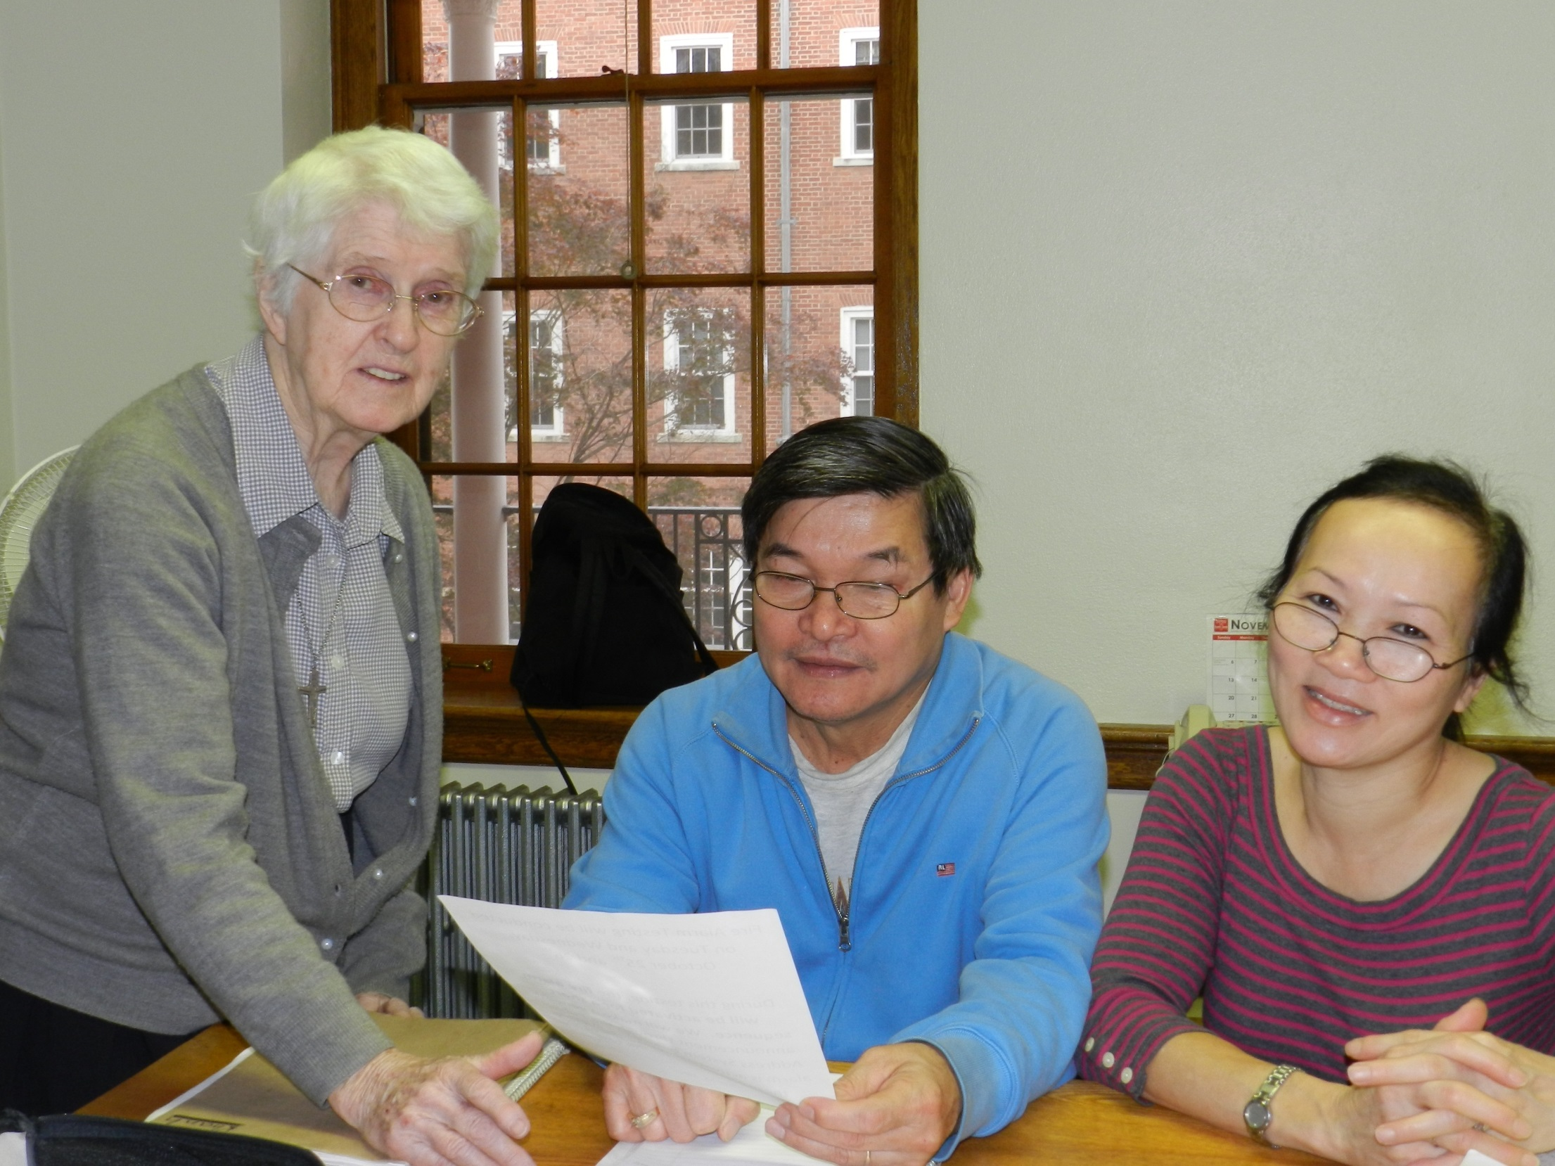
Tu sabes bien que lo que tengo
Tu sabes bem que em meu barco
Lord, you knew what my boat carried

Slide 11
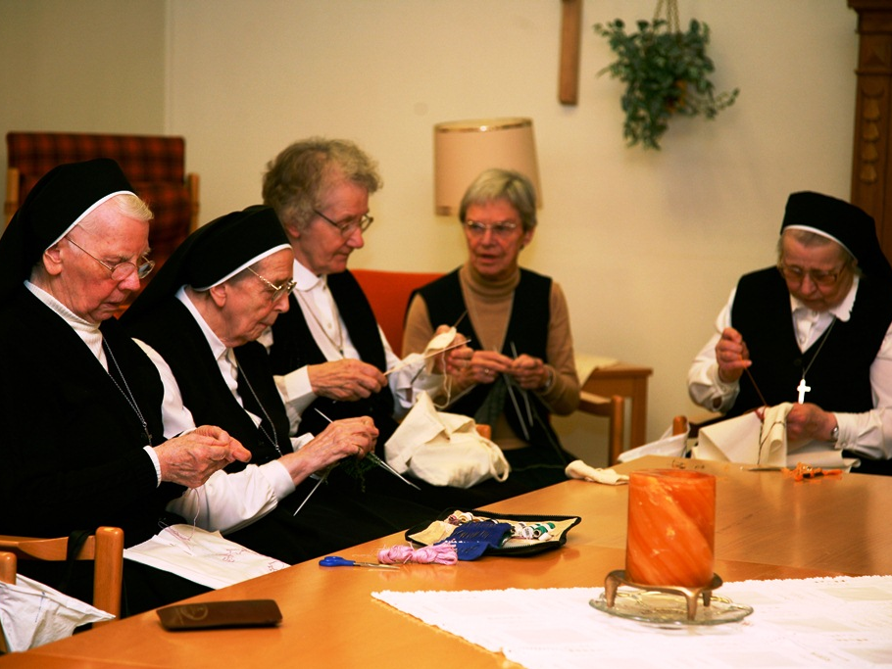
En mi barca no hai oro ni plata
Eu não tenho espadas nem ouro
Neither money nor weapons for fighting

Slide 12
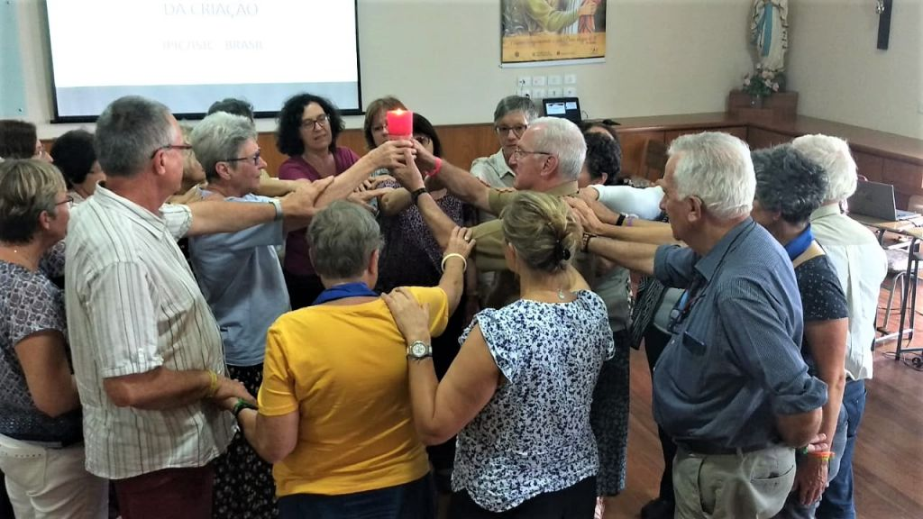
Tan solo redes y mi trabajo
Somente redes e o meu trabalho
But nets for fishing my daily labor

Slide 13
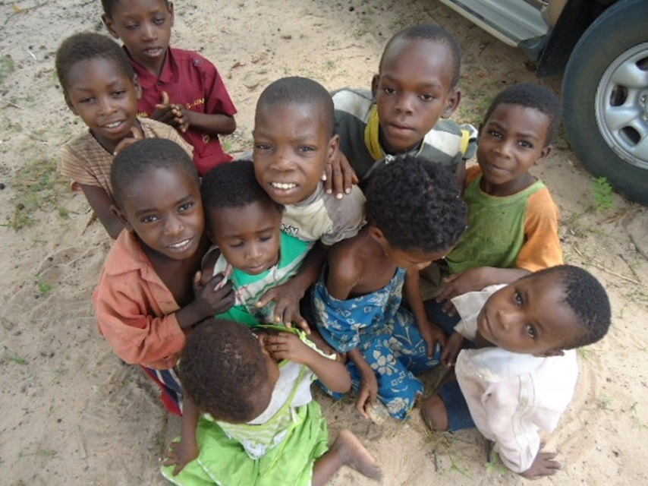
Señor, me has mirado a las ojos
Senhor, Tu me olhaste nos olhos
O Lord, in my eyes you were gazing

Slide 14
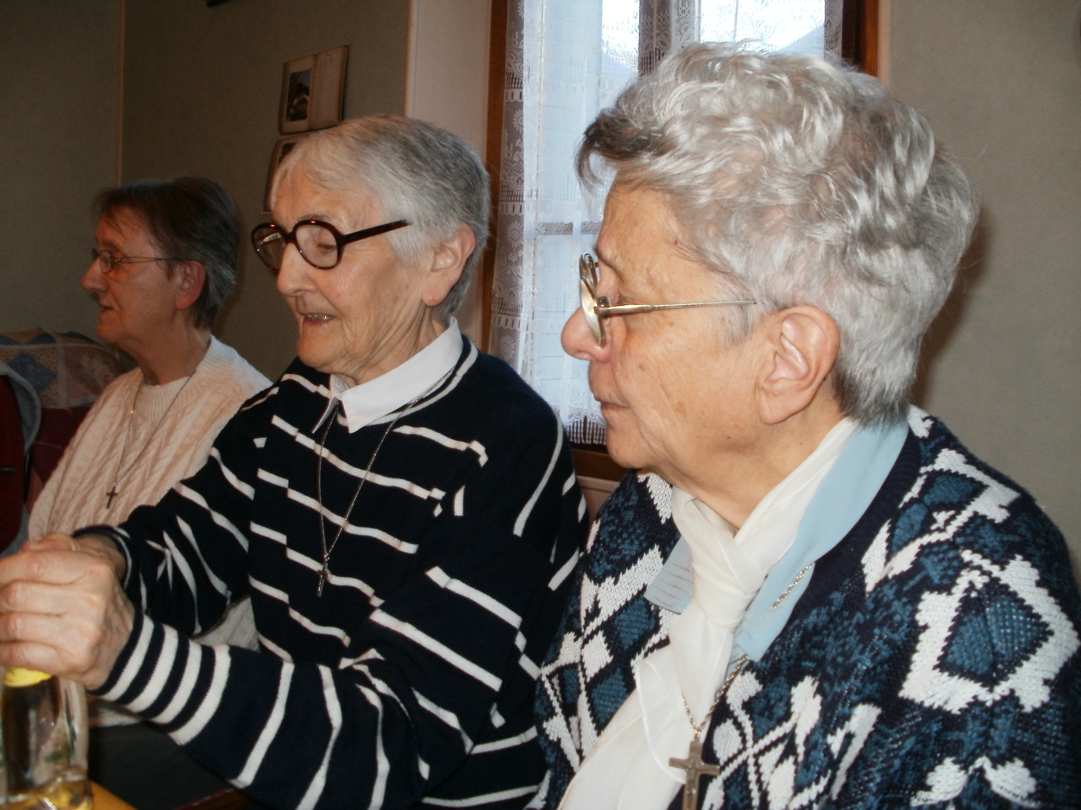

Slide 15
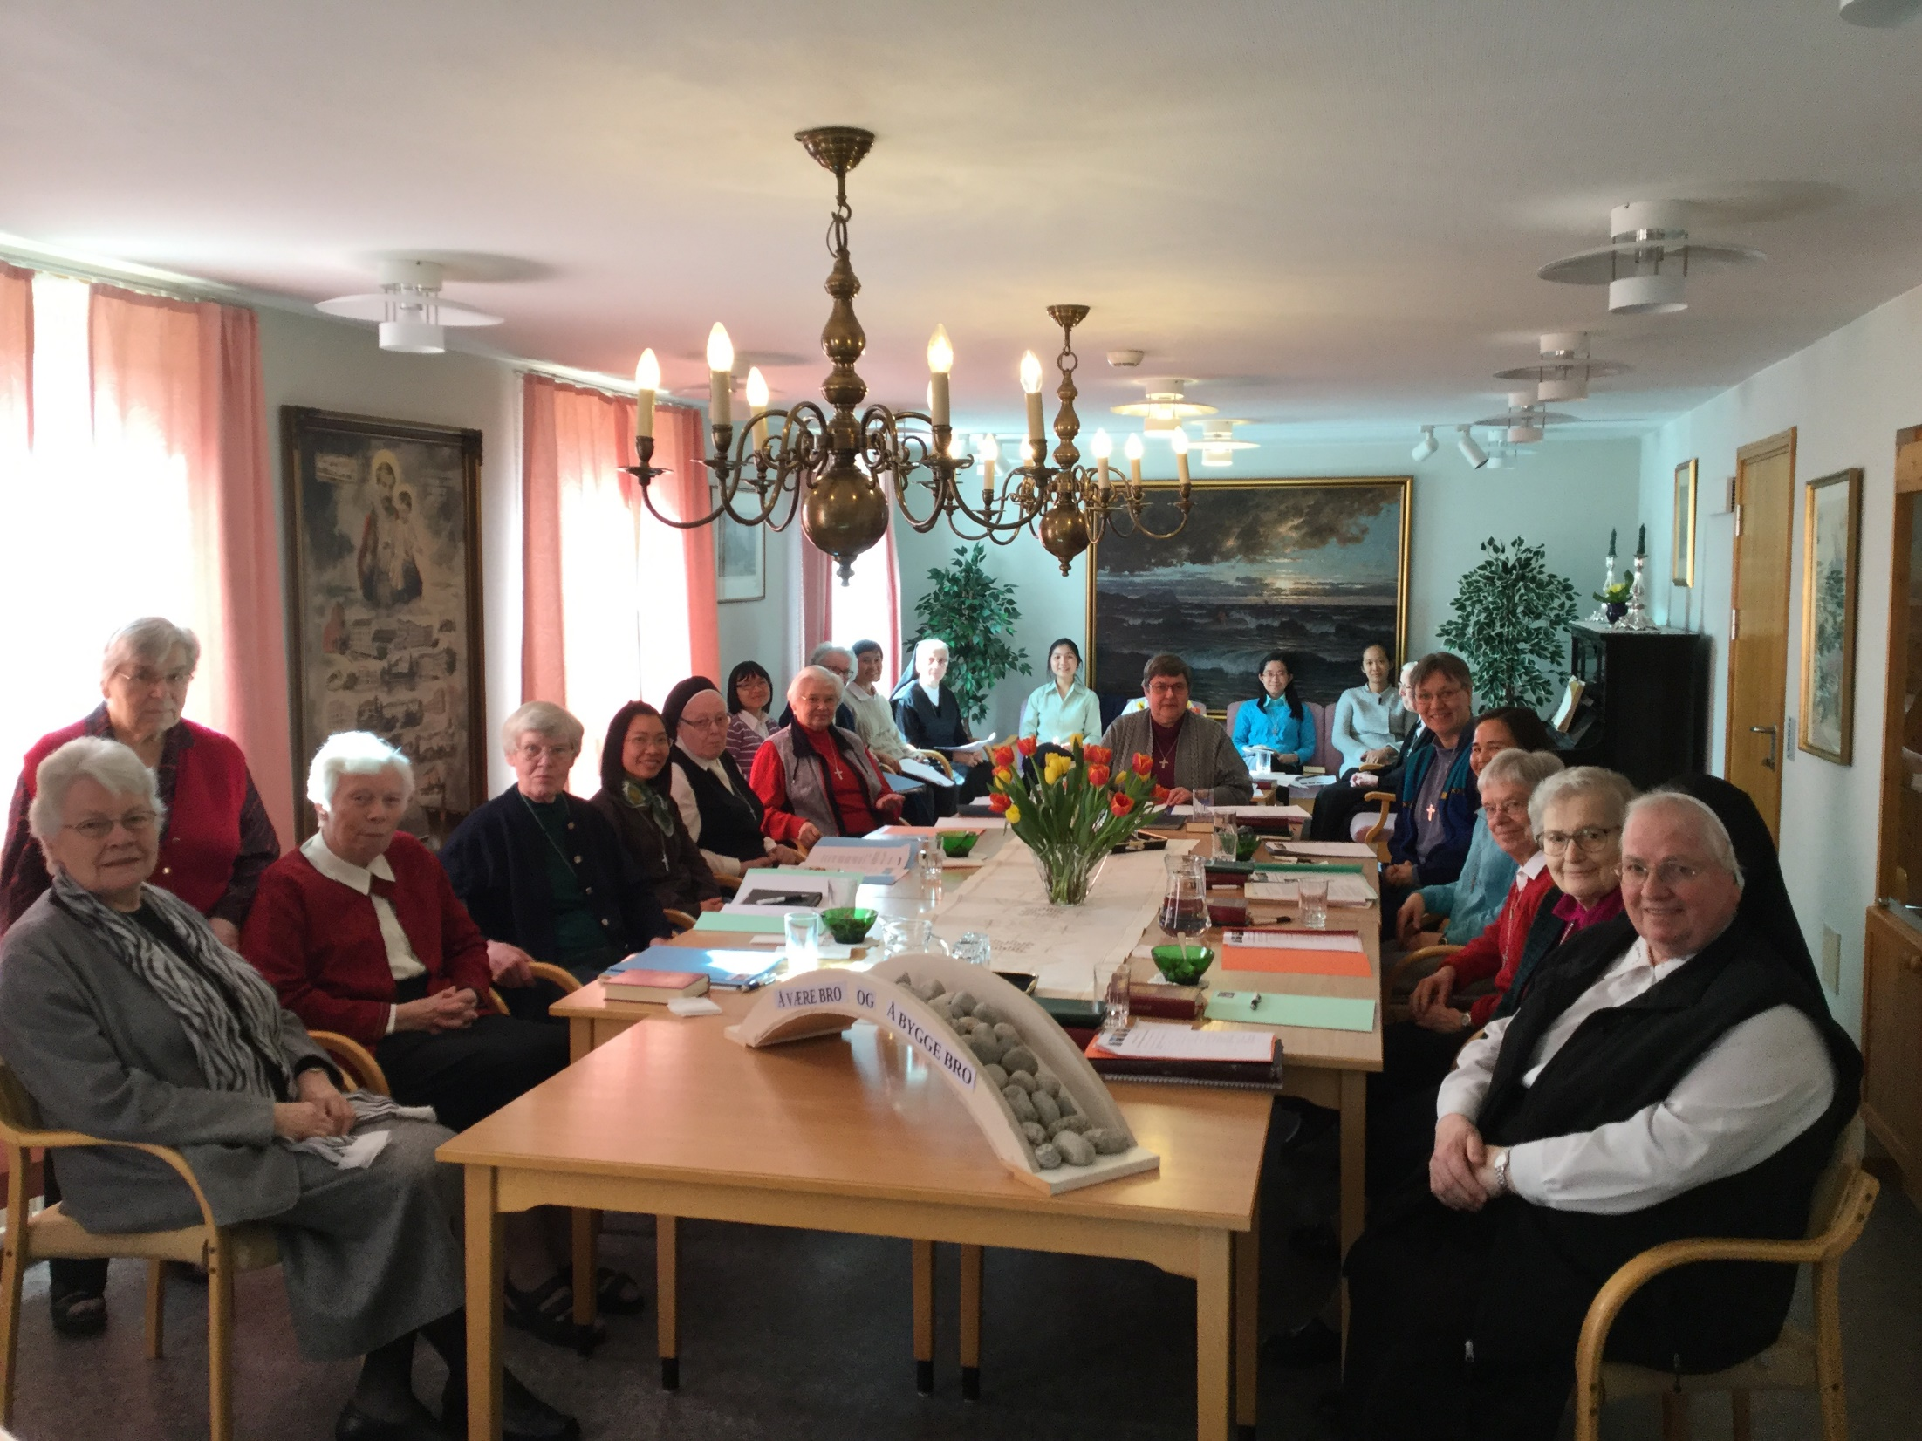

Slide 16
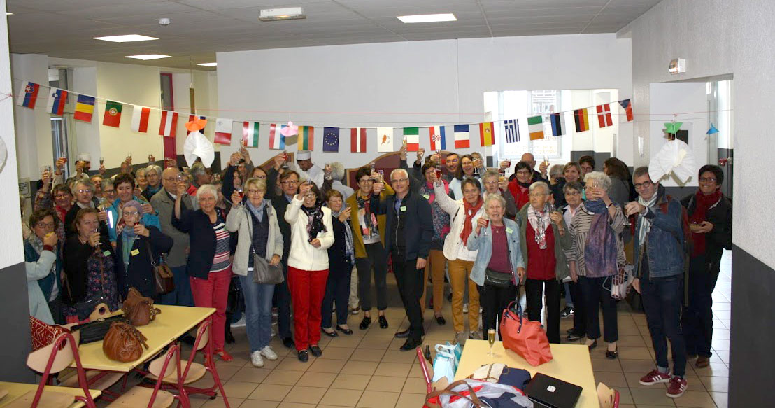
Junto a ti buscare outro mar
Junto a Ti, buscarei outro mar.
Close to you, I will find other seas.

Slide 17
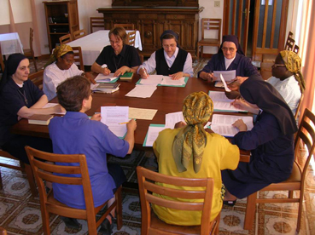
Tu necessitas mis manos
Tu, minhas mãos solicitas
Lord, send me where you would have me

Slide 18
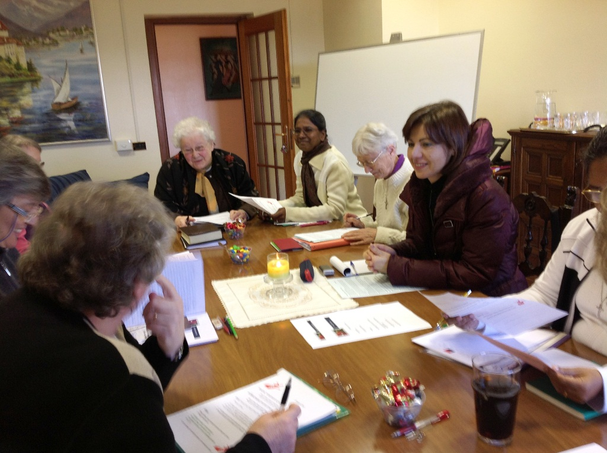
Mis cansancios que a otros descansen
Meu cansaço que outros descansem
To a village, or heart of the city

Slide 19
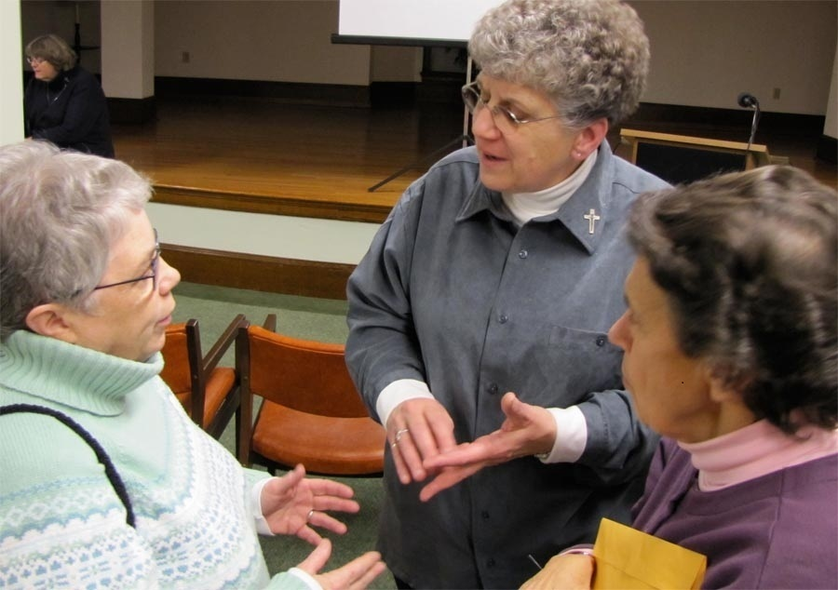
Amor que quiera seguir amando
Amor que almeja seguir amando
I will remember that you are with me

Slide 20
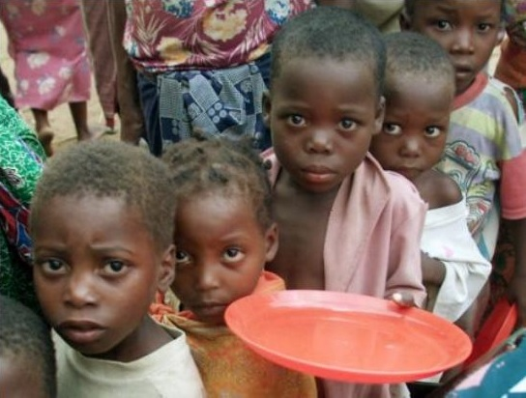
Señor, me has mirado a las ojos
Senhor, Tu me olhaste nos olhos
O Lord, in my eyes you were gazing

Slide 21
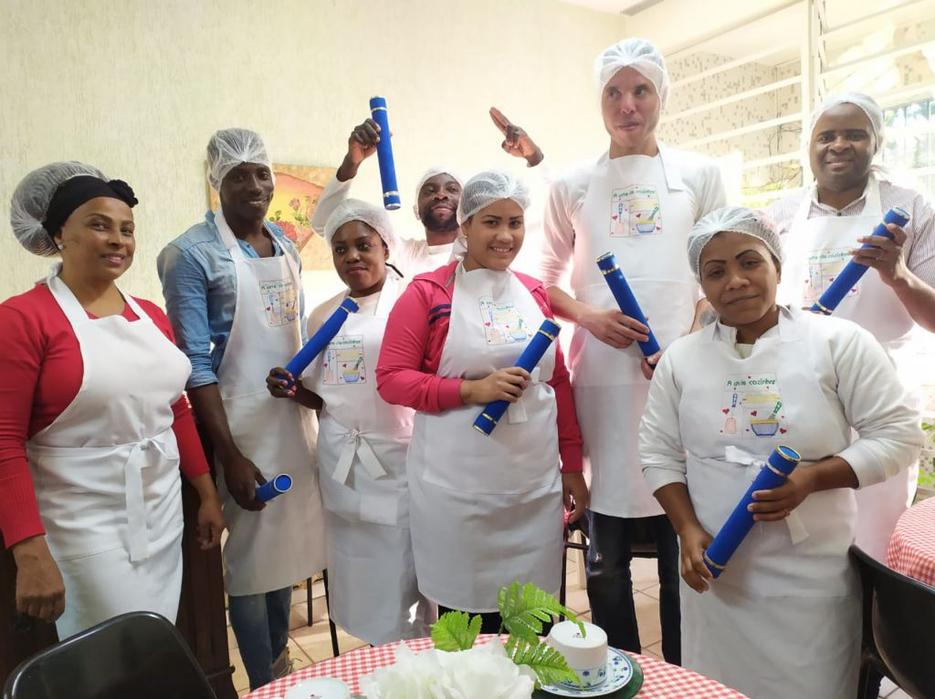
Soriendo, has dicho mi nombre
A sorrir, pronunciaste meu nome
Kindly smiling my name you were saying

Slide 22
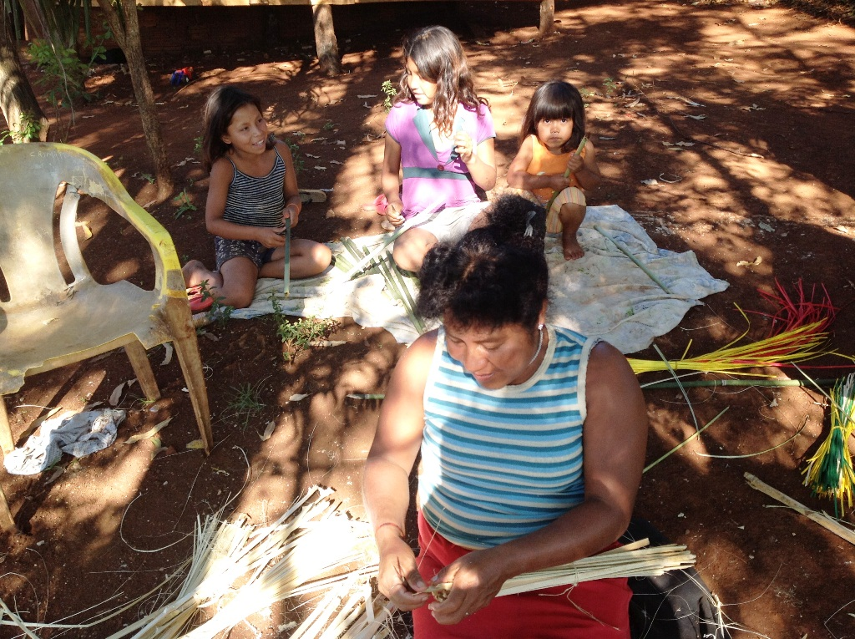
En la arena, he dejado mi barca
Lá na praia, eu deixei o meu barco
All I treasured, I have left on the sand there

Slide 23
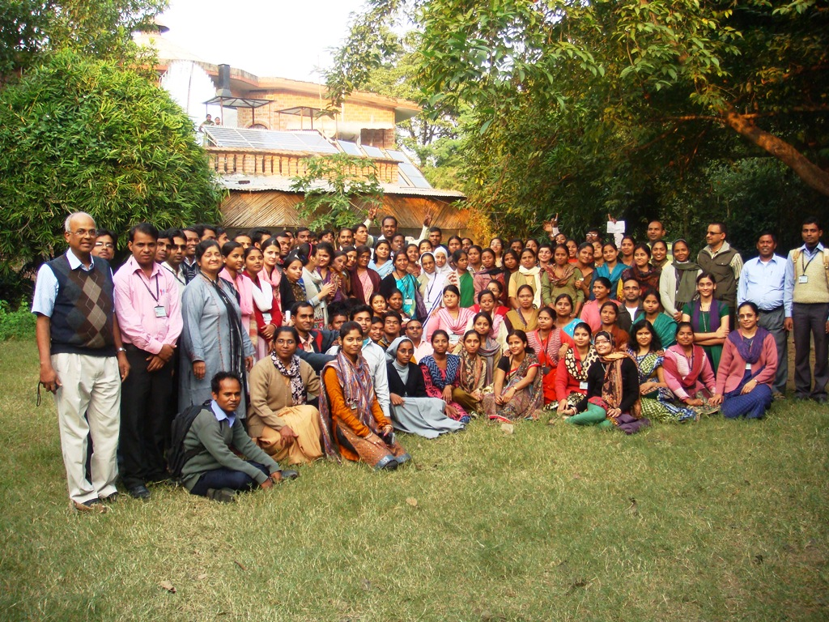
Junto a ti, buscare outro mar
Junto a Ti, buscarei outro mar
Close to you, I will find other seas

Slide 24
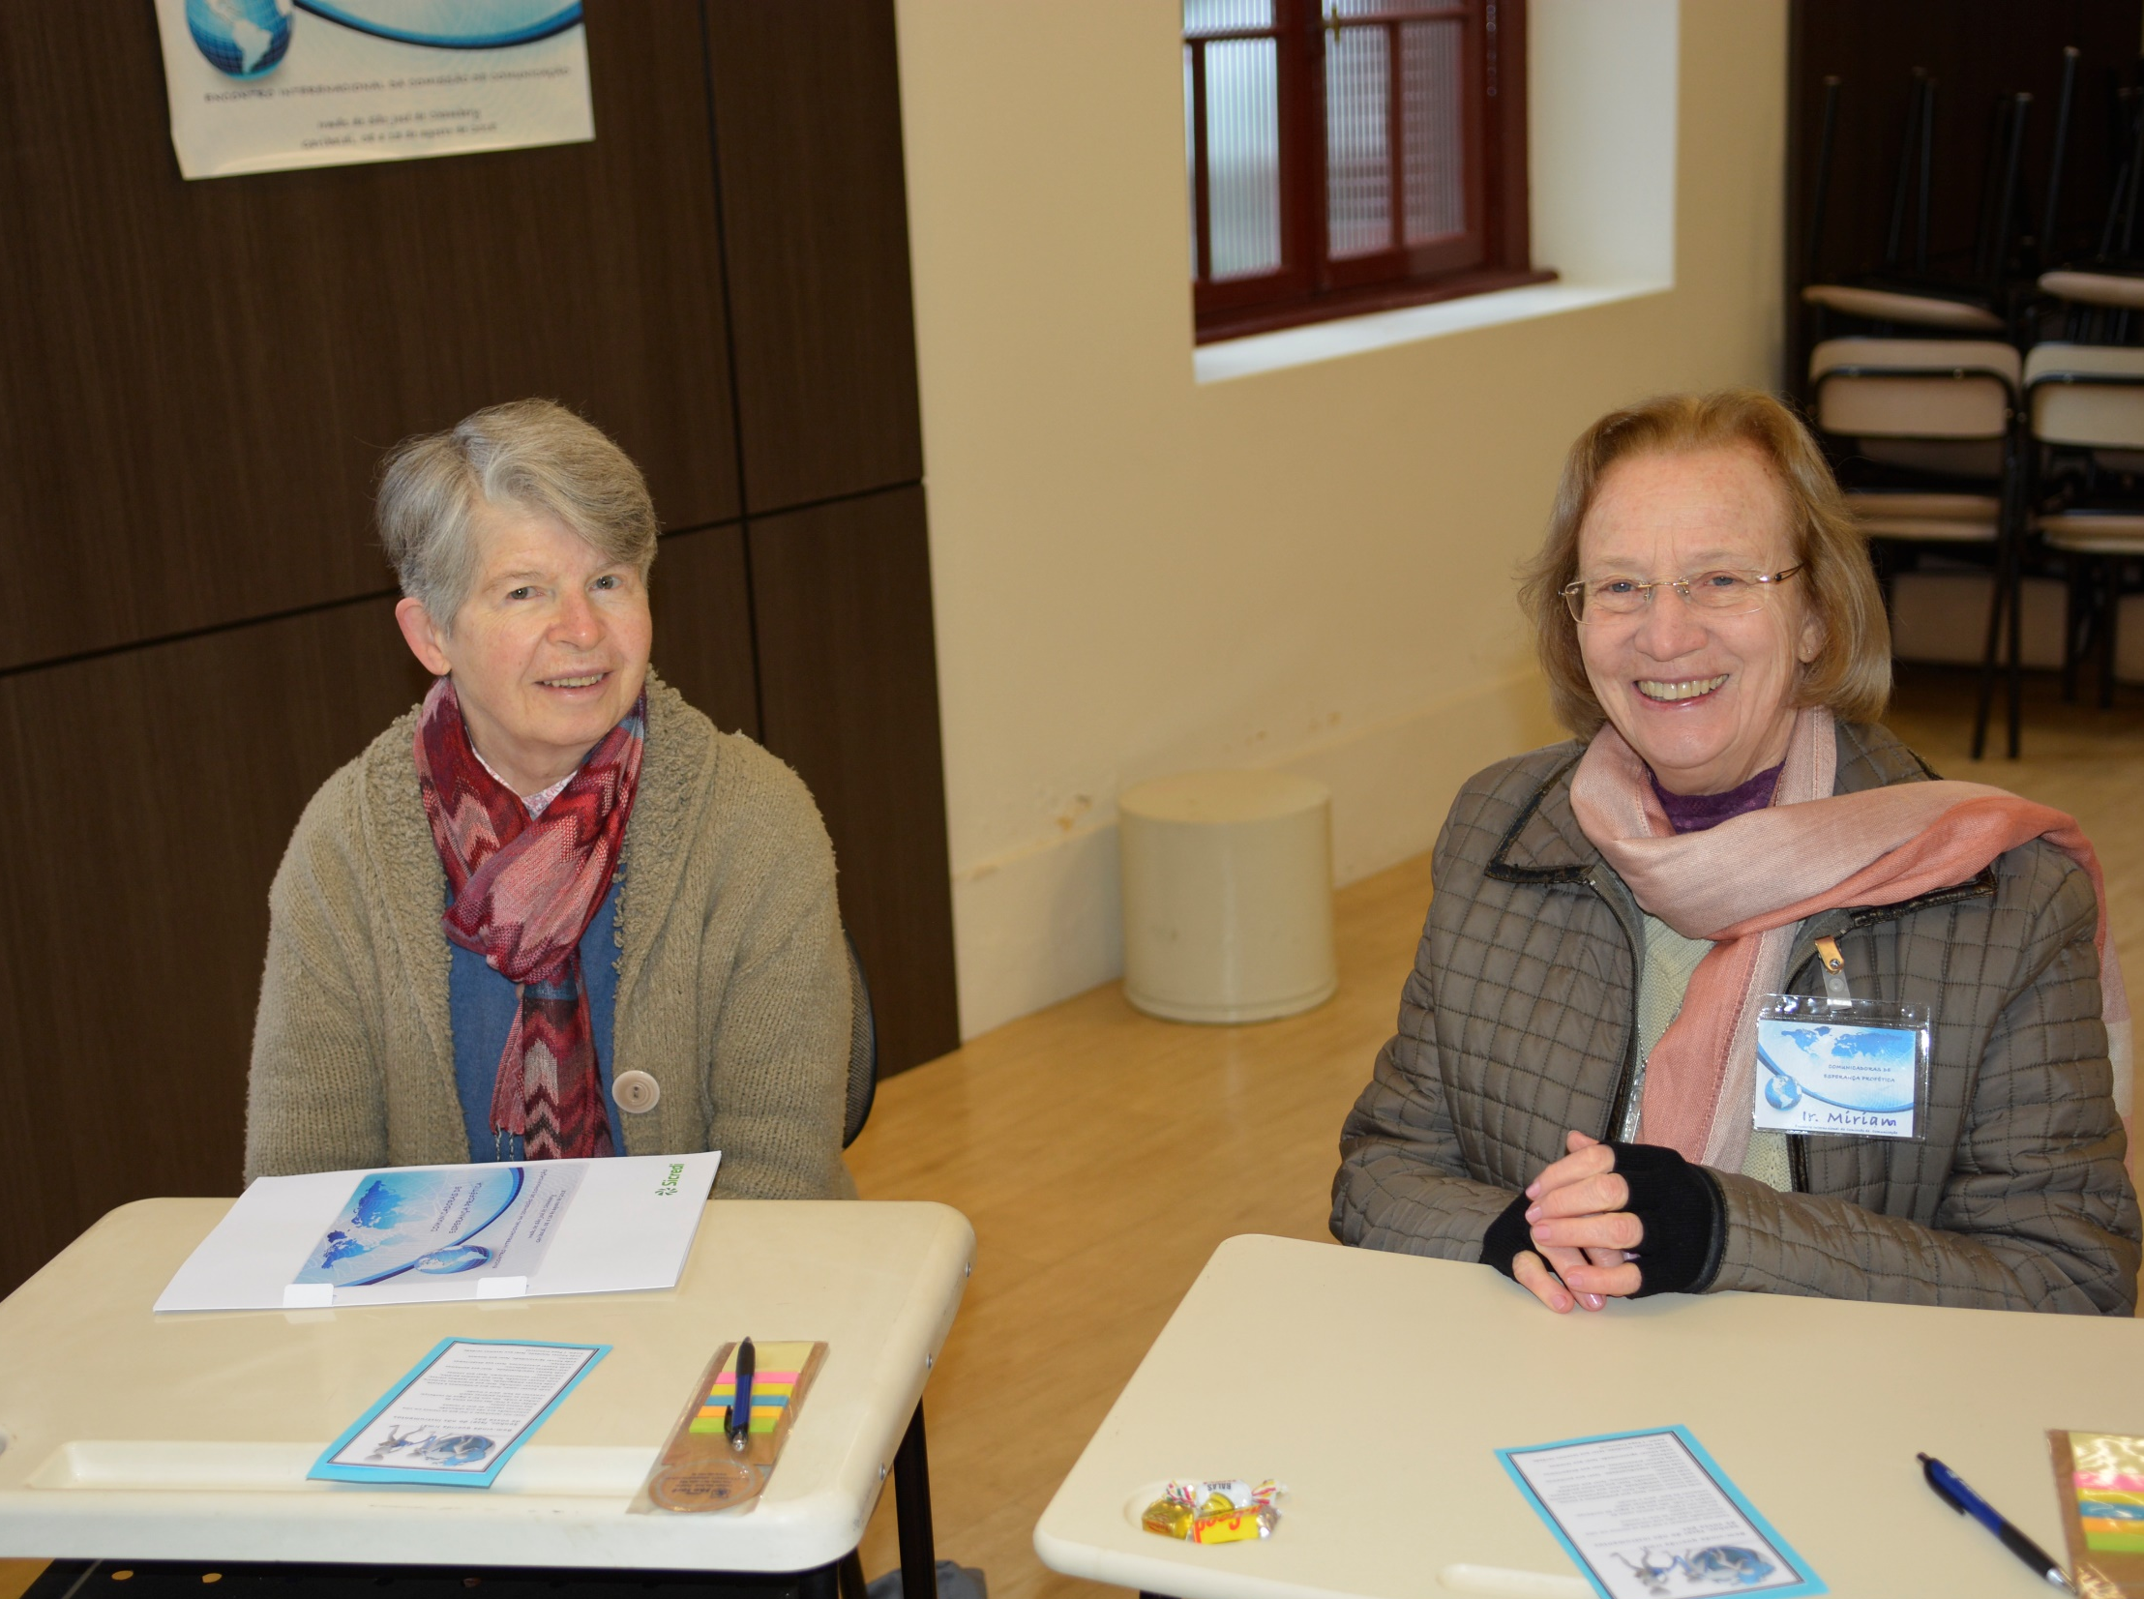
Tu, pescador de otros mares
Tu, pescador de outros lagos
Toi le pêcheur d’autres mers

Slide 25
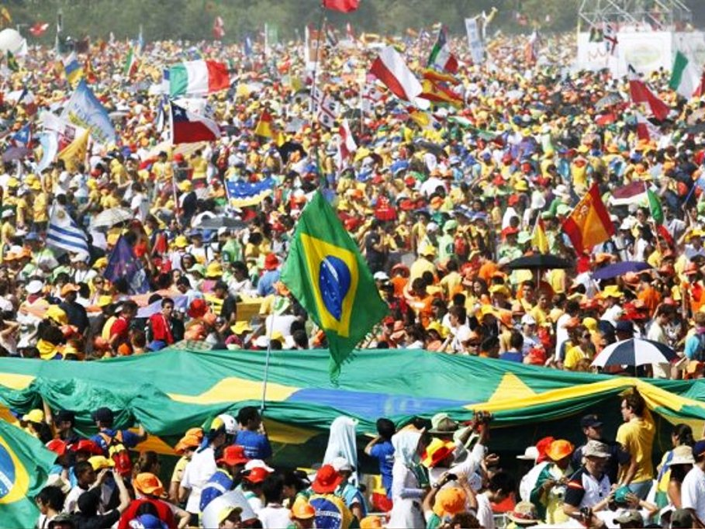
Ansia eterna de almas que esperam
Ânsia eterna de almas que esperam
Désir eternel des âmes em attente

Slide 26
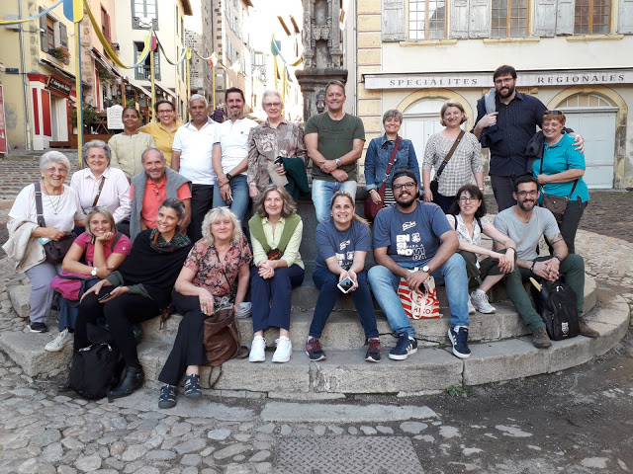
Amigo bueno que asi me llamas
Bondoso amigo, assim me chamas
Tu es un bom ami. C’est ainsi que tu m’appelles

Slide 27
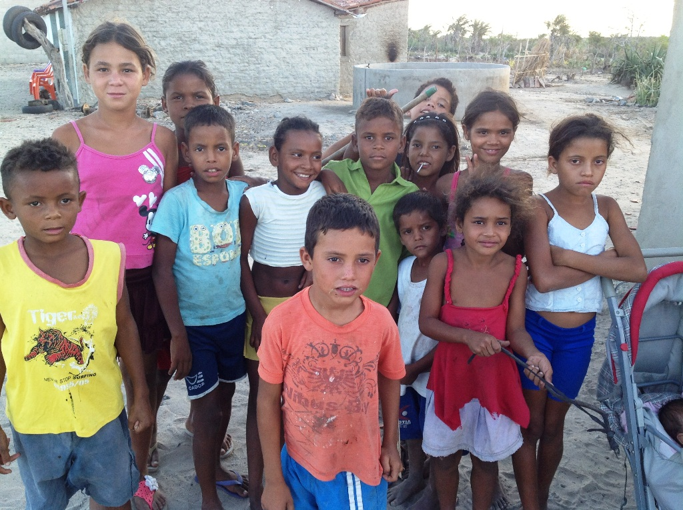
Señor, me has mirado a las ojos
Senhor, Tu me olhaste nos olhos
O Lord, in my eyes you were gazing

Slide 28
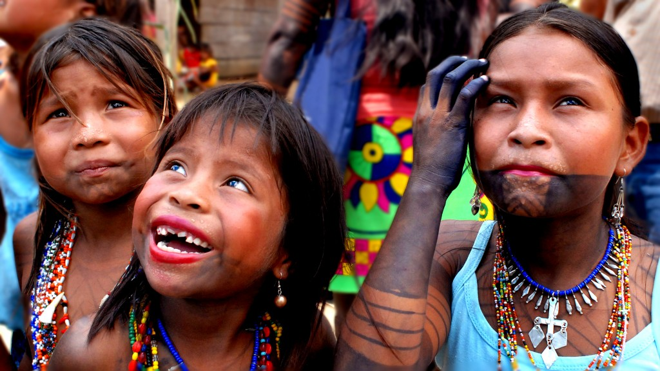
Soriendo, has dicho mi nombre
A sorrir, pronunciaste meu nome
Kindly smiling my name you were saying

Slide 30
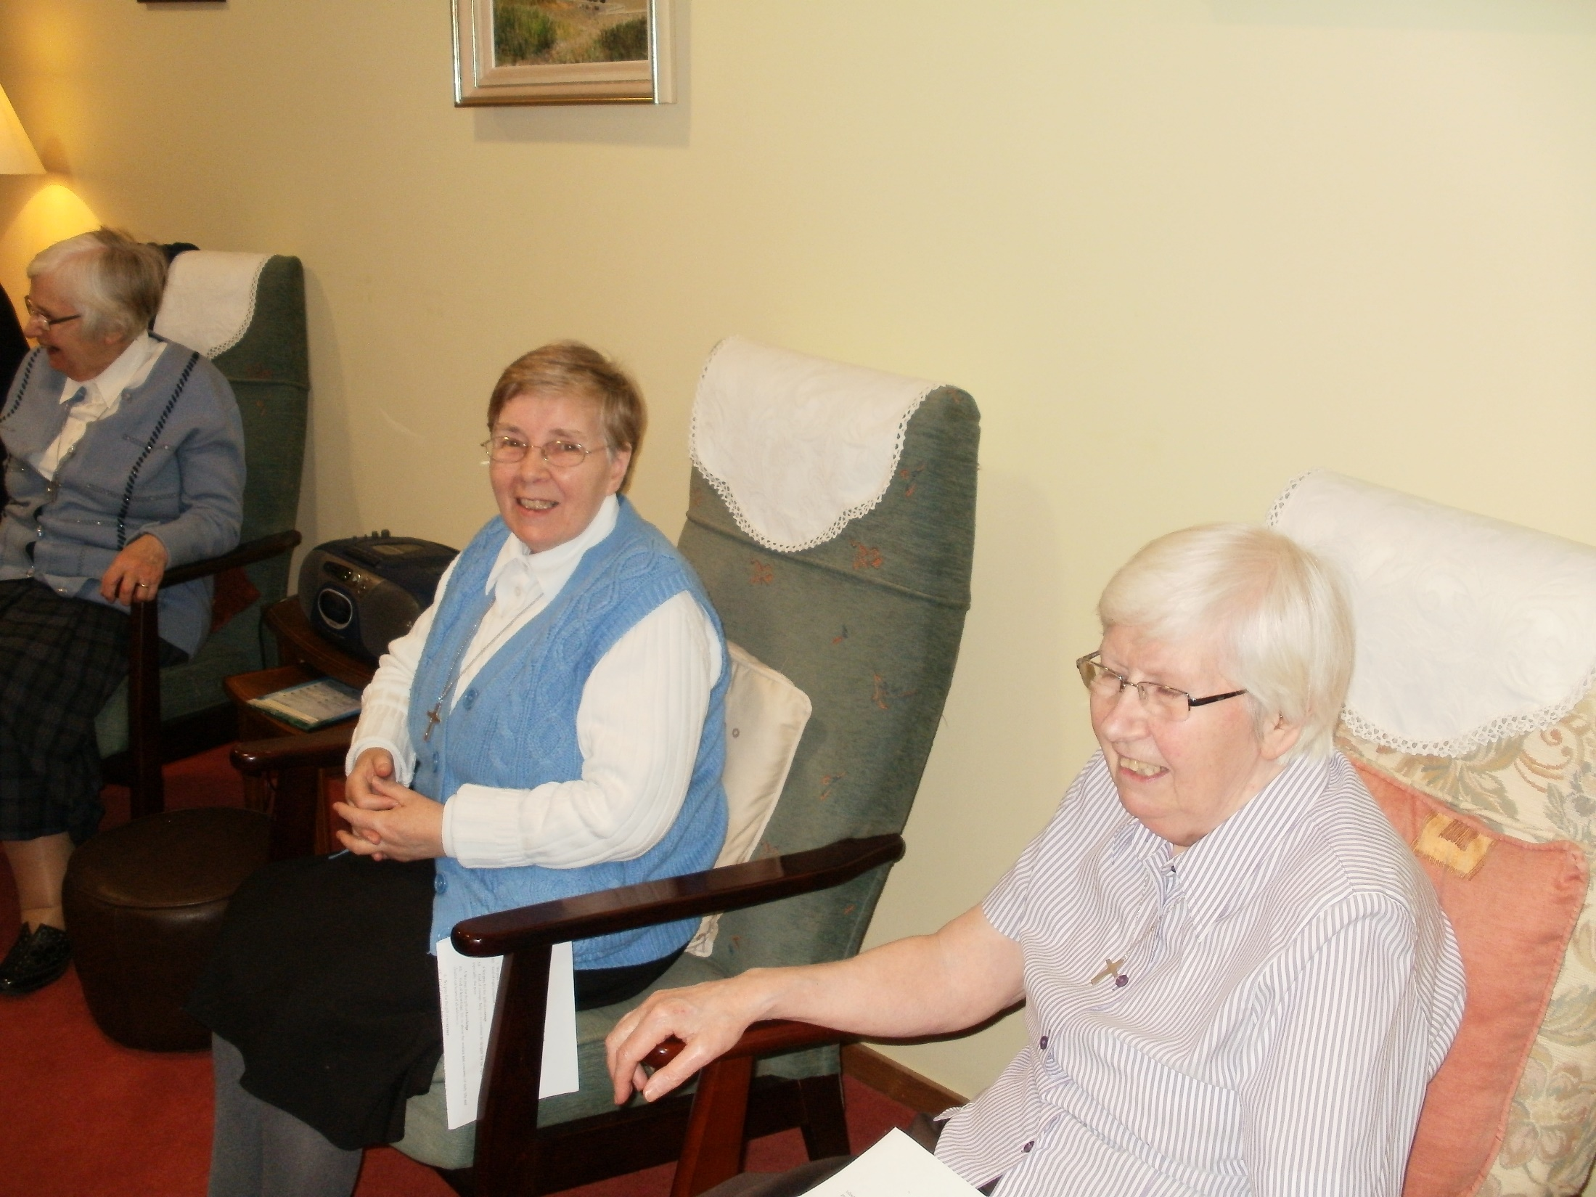
Junto a Ti, buscare outro mar
Junto a Ti buscarei outro mar
Close to you, I will find other seas.

Slide 31
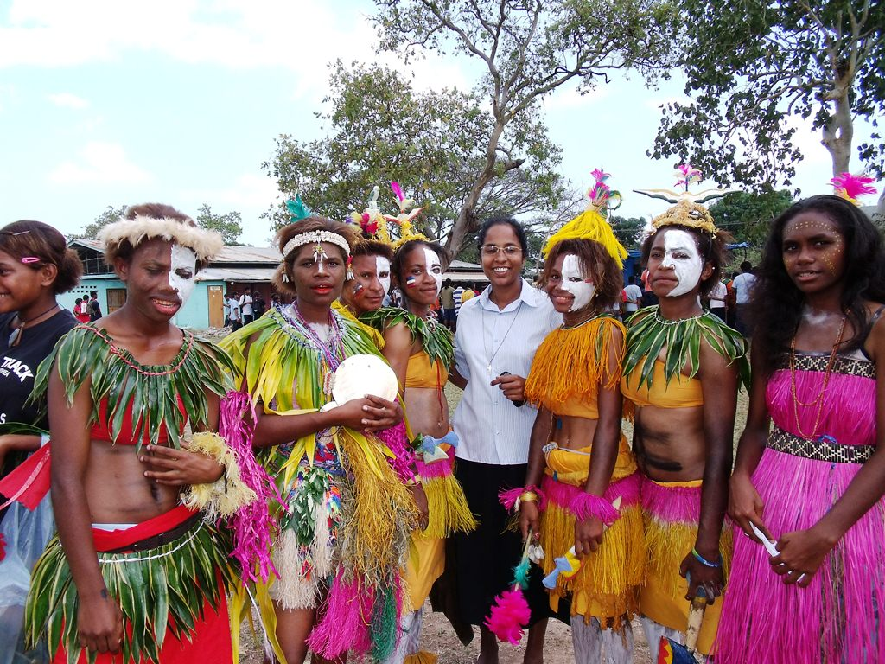
Junto a ti buscare outro mar
Junto a Ti, buscarei outro mar.
Close to you, I will find other seas.

Slide 32
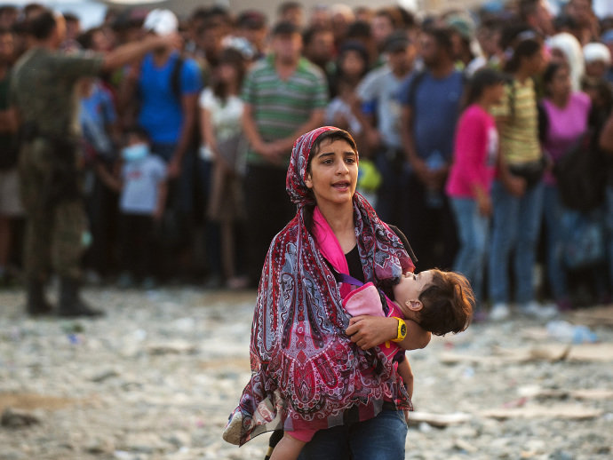
Junto a ti buscare outro mar
Junto a Ti, buscarei outro mar.
Close to you, I will find other seas.

